Slide 1
Experiences from developing a Holistic Framework for Integrated Public Services
June 27th, 2023
Noemi Milo

Slide 2
The inGOV project

Slide 3
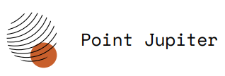
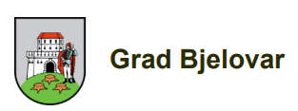
Project Description
Three-year project, funded by the EC’s Horizon 2020 program (2021-2023)
Overall objective: Enable European PAs to co-create user-friendly and inclusive integrated public services (IPS)
Deloitte is responsible of the creation of an IPS Holistic Framework
The Consortium
MALTA
AUSTRIA
inGOV pilots
GREECE
CROATIA

Slide 4
The IPS Holistic Framework

Slide 5
The IPS Holistic Framework is a conceptual model, composed of recommendations and KPI, to support IPS co-creation and governance
Governance
Design
Delivery
Evaluation
The framework in a nutshell
Stakeholders’
role and
engagement
Implementation
Aspects*
Agreements
All recommendations converge in a straightforward action plan:
the IPS Agile Roadmap
* Political, Technical/Semantical, Organisational, Legal aspects

Slide 6
The IPS holistic framework has been characterized by an iterative release, to be completed by December 2023.
SYSTEMATIC LITERATURE REVIEW
CASE RESEARCH METHODOLOGY
VALIDATION
The methodology
Desk research on the 5 pillars and extensive analysis on how to integrate EU publications, e.g. EIF and ISA²
Practical analysis of 5 European IPS best practices (3 from ISA²)
Experience of inGOV pilots
Insights from other H2020 projects
Continuous validation from pilots (through workshops and surveys)
Final workshop will be held with relevant stakeholders

Slide 7
The IPS Agile Roadmap

Slide 8
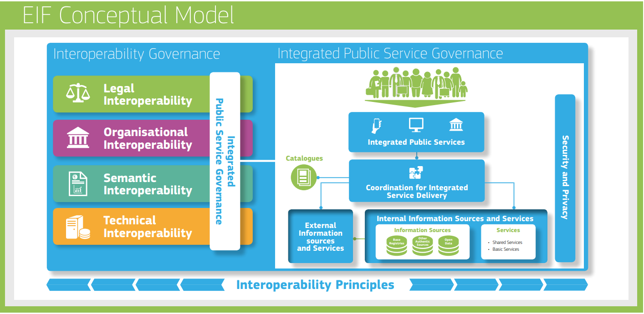
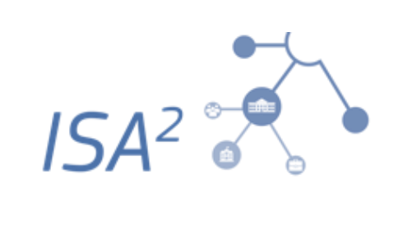
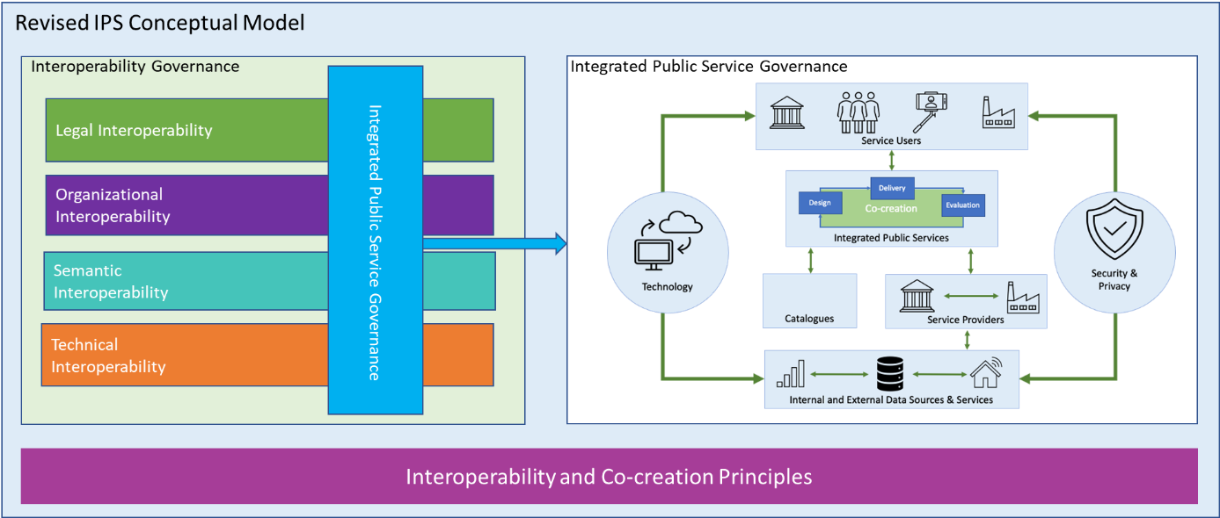
The inputs
IPS Agile roadmap – sources and results
The output
1
Grounding building block
4
Consequential steps
Agile methodologies present benefits such as increased flexibility, continuous improvement and product validation, BUT they tend to have strict rules of implementation. Thus, we tried to include blended elements of agility that can fit the complexity of IPS delivery.
Agility

Slide 9
Design
Delivery
Evaluation
1. Understand the environment
Collection of needs from community and stakeholders
Strong political involvement
Early assessment of existing (legal and technical) frameworks
2. Plan the journey
Map stakeholders and assign roles and responsibilities
Set up governance bodies, communication channels and the project report
Ensure inclusiveness and accessibility
Define a tailored plan: divide user requirements into sprints
3. Drive the change
Release in iterations
Ensure training
Keep open communication
Adapt standard and vocabularies
Regularly align operational priorities
Always communicate expectations during co-creation activities
4. Monitor the evolution
Capture feedback and feed it back into the IPS development
Monitor KPI
Communicate results, favor active knowledge sharing and propose legislative changes (if applicable)
Stakeholder engagement

Slide 10
Stakeholder Engagement
What makes inGOV proposal different from traditional approaches is the systematic inclusion of users through co-creation approaches. User feedback is also the underlying assumption of agile product development.
1. Understand the environment
The first step is all about observing, collecting needs and creating the conditions to challenge the status quo, create momentum and introduce the new IPS. In this preliminary step requirements are gathered, political figures are involved and existing infrastructure are scanned.
The blocks
2. The design phase: Plan the journey
The second step involves planning, preparing and mapping. This includes stakeholder mapping, setting up governance bodies, defining a reasonable plan. We emphasize the importance of transparency, clarity and inclusiveness.
3. The delivery phase: Drive the change
Co-creation favors the logic of delivery in iterations, but to make it effective, stakeholders must be constantly informed and trained but also given the opportunity to provide feedback also after release. Standards and vocabulary shall be regularly adapted to changing needs as well as operational priorities.
4. The evaluation phase: Monitor the evolution
In the final phase, user centrality is at its utmost. Feedback from diverse stakeholders shall be monitored by appointed team members and fed back into the process. KPIs should be properly monitored. The last phase is an opportunity for active knowledge sharing and also to propose potential legislative changes.

Slide 11
The floor is yours!

Slide 12
What role do you think co-creation might play in the provision of public services in the near future?
Please let us hear your comments and suggestions! Thank you!
The floor is yours!

Slide 13
Speaker
Noemi Milo
nmilo@deloitte.it
Thank you for your attention!

